Slide 1
Prediction of particulate matter (pm2.5) in Lucknow, india
Shaunak Phatak

Slide 2
Outline
Problem Context and Definition
Data Wrangling and Exploratory Data Analysis (EDA)
Modeling Results
Conclusion

Slide 3
Problem context
Air pollution is a serious health hazard with 8.8 million deaths globally
Particulate matter is very harmful due to its microscopic size entering lungs and bloodstream
Serious problem in India with 0.98 out of 1.67 million deaths due to particulate matter in 2019
Project aims at using publicly available pollution data to create a forecasting model for particulate matter (PM2.5)
Model can be further extended into an app to warn people and provide recommendations to take necessary precaution
Reference: https://www.gettyimages.in/detail/illustration/deadly-smoke-pollution-from-industrial-smoke-royalty-free-illustration/485276208?adppopup=true

Slide 4
Problem Definition
Create an hourly forecasting model for particulate matter (PM2.5) in Lucknow, India applying supervised learning for a multivariate time series dataset
Dataset Information:
Pollution data - Central Pollution Control Board, India
Temperature data - National Oceanic & Atmospheric Administration
Independent Variables: Weather, other air pollutants and time based features
Dependent Variable: PM2.5

Slide 5
Data wrangling and eda
Missing values for the dependent variable (PM2.5) were dropped
Missing values for independent variables were imputed by their column means
Outlier treatment methods tested:
Percentile Capping
Bounding by 3 standard deviations
Did not use the above methods due to significant changes to the data distribution

Slide 6
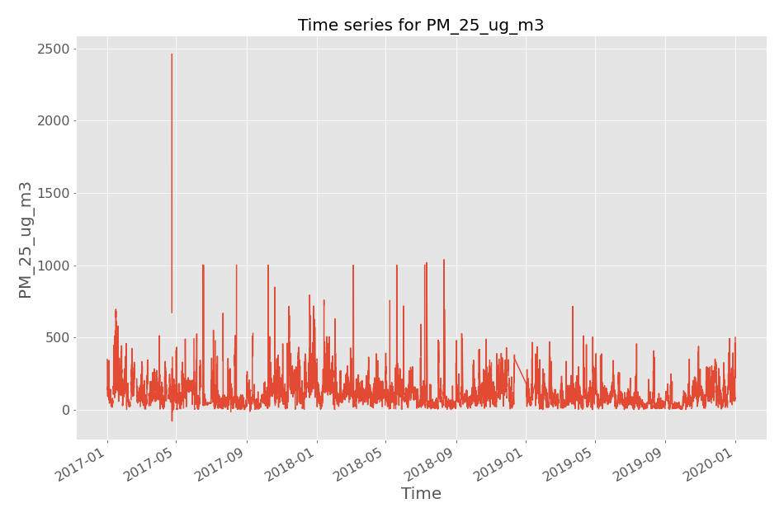
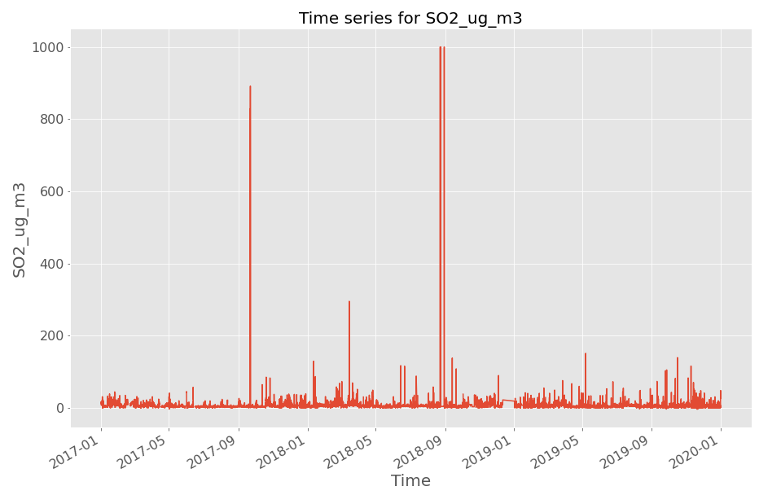
Data wrangling and eda
Some outliers as marked on the figures were removed for PM2.5 and sulphur dioxide
No other outlier changes were made

Slide 7
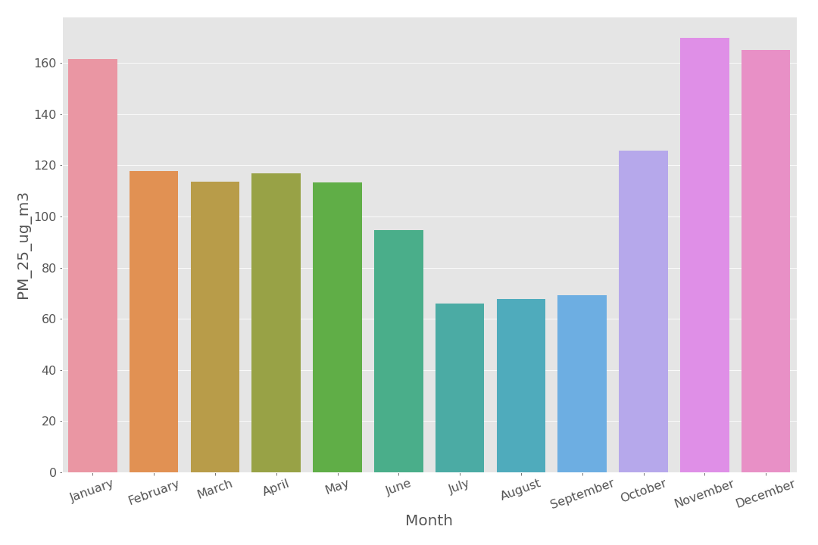
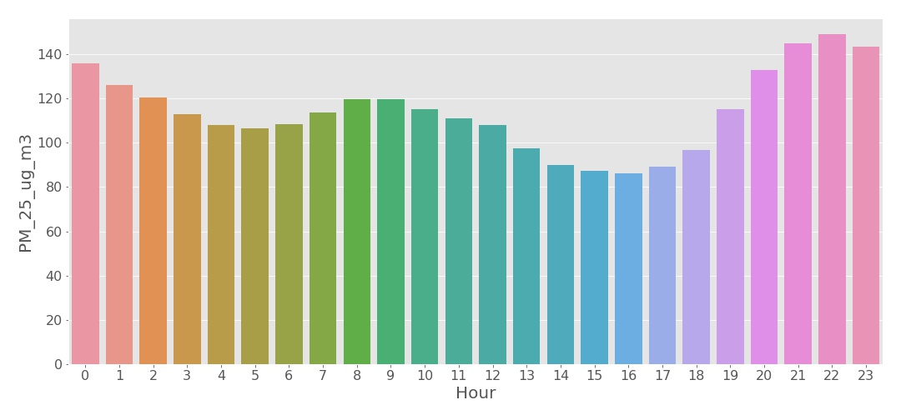
Data wrangling and eda
Extracted time based features from the date-time index
Cyclic variations in PM2.5 concentration across month as well as hour of day

Slide 8
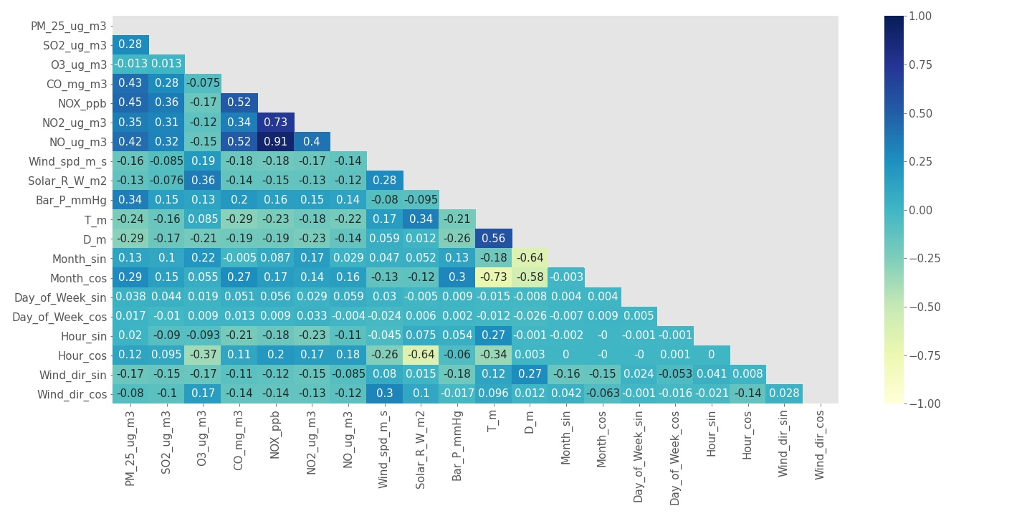
Data wrangling and eda
Negative correlation between PM2.5 and temperature and wind speed
Moderate positive correlations between PM2.5 and other pollutant features
Multicollinearity between other pollutant features
Heat map also shows cyclical features converted to sine and cosine components to retain cyclical information

Slide 9
Modeling
Modeling studies involved two case studies:
Performance Comparison for randomly split train/test sets versus splits on temporal order
Comparing model performances while applying walk forward validation
Nested cross validation to tune hyperparameters
Tuning lag features for PM2.5 as a hyperparameter
Check effectiveness of using some or all features

Slide 10
Modeling:
Random vs time series split
Split | Lag Features | Avg. Train RMSE | Avg. Test RMSE | Avg. Train MAE | Avg. Test MAE
Random Split | No | 59.28 | 72.18 | 36.78 | 47.93
 | Yes (3) | 28.66 | 36.89 | 13.7 | 16.34
Time based Split | No | 67.94 | 83.22 | 40.5 | 59.17
 | Yes (3) | 30.92 | 33.87 | 14.07 | 16.95
Random split performed better than time series split without any lag features
Similar performance when lag features were added
All features were used for these studies without any feature selection process
Results for a Light Gradient Boosting Model

Slide 11
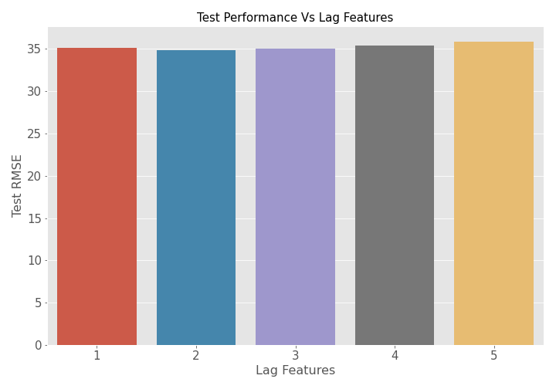
Modeling
Tuning the lag feature
No performance improvements beyond using the 1st lag feature
Similar behavior across all models tested

Slide 12
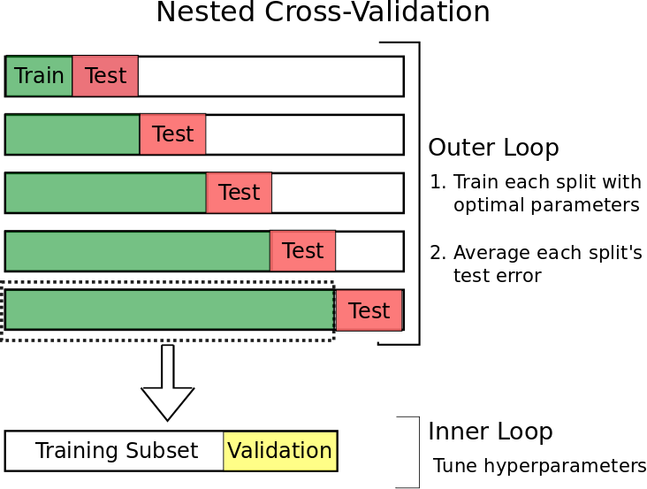
Modeling
Time series split avoids data leakage that can happen for random splits
Nested cross-validation avoids a problem of choosing an arbitrary test set to make predictions
Reference: https://towardsdatascience.com/time-series-nested-cross-validation-76adba623eb9

Slide 13
Modeling:
Walk forward validation Results
Model | Avg. Train RMSE | Avg. Test RMSE | Avg. Train MAE | Avg. Test MAE
Random Forest | 37.49 | 33.56 | 14.82 | 15.66
Gradient Boost | 38.62 | 34.35 | 17.39 | 16.62
Light Gradient Boost | 38.6 | 33.85 | 16.88 | 16.22
XGBoost | 38 | 34.05 | 16.68 | 16
1st lag and time features sufficient to maximize modeling performance
Weather and pollutant variables were not useful to further improve performance
Average test set metrics similar across all models
Models based on a 3 splits for train/test as well as nested cross-validation

Slide 14
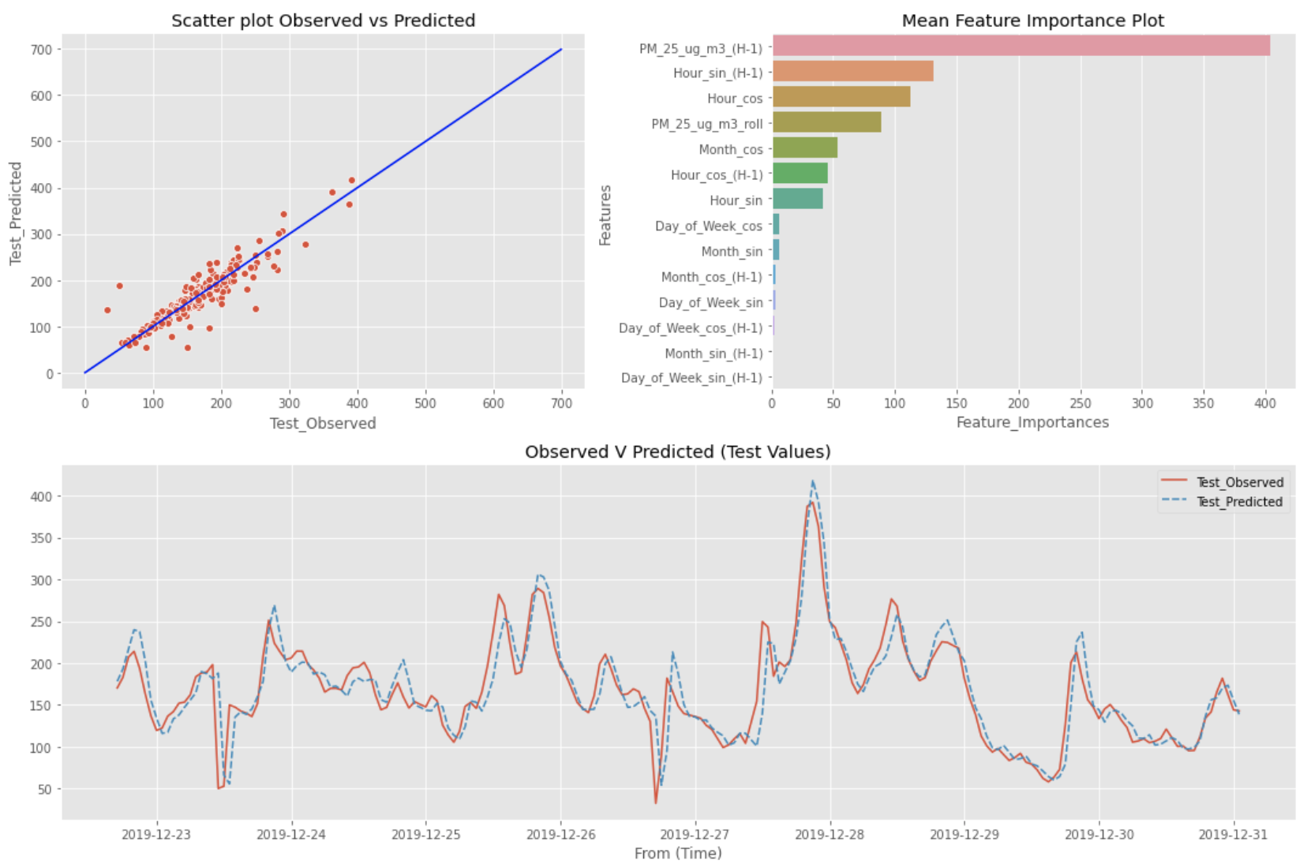
Modeling:
Walk forward validation Example
Modeling results for 200 hourly walk forward predictions using Light Gradient Boost
1st lag feature had the highest importance

Slide 15
Conclusions
Project aimed to predict hourly PM2.5 values using supervised learning for a multivariate time series
Performance Comparison between random split and time series split
Random split fared better when no lags were added
Similar performance with lag features
Improved performance with lag features
Model Comparison with Walk forward nested cross-validation
1st lag and time features sufficient to maximize performance
Weather and pollution features not useful to improve model results
Similar performance across all models tested
Light Gradient Boost can be chosen as a final model due to its fast training time

Slide 16
References
https://www.theguardian.com/environment/2019/mar/12/air-pollution-deaths-are-double-previous-estimates-finds-research
https://ourworldindata.org/air-pollution
https://www.epa.gov/pm-pollution/particulate-matter-pm-basics#PM
https://www.thelancet.com/journals/lanplh/article/PIIS2542-5196(20)30298-9/fulltext
https://www.researchgate.net/publication/341618027_Forecasting_Sales_of_Truck_Components_A_Machine_Learning_Approach
https://towardsdatascience.com/time-series-nested-cross-validation-76adba623eb9
https://machinelearningmastery.com/backtest-machine-learning-models-time-series-forecasting
https://medium.com/mongolian-data-stories/ulaanbaatar-air-pollution-part-1-35e17c83f70b
https://machinelearningmastery.com/convert-time-series-supervised-learning-problem-python/

Slide 17
Appendix
Project files on GitHub: https://github.com/phatakshaunak/Springboard-Data-Science/tree/master/Capstone%20Project%20%232

